Slide 1

Specification-based
testing
Chapter 2
https://www.effective-software-testing.com

Slide 2
What are the top-3 keywords (max 2 terms each) that best sum up the content of the chapter?

Slide 3
What is Chapter 2 about?
Specification-based testing
Focus on the specification, not on the code
Breaking down the specification into parts
Analyze inputs and outputs, their domain, and how they can change the output of the program
Boundary testing
Between partitions
On and off points
Specification-based testing in practice
Iterative, not sequential
How far should we go?
Vary the inputs
Go for the simplest input
Pick reasonable inputs
Works at any level

Slide 4
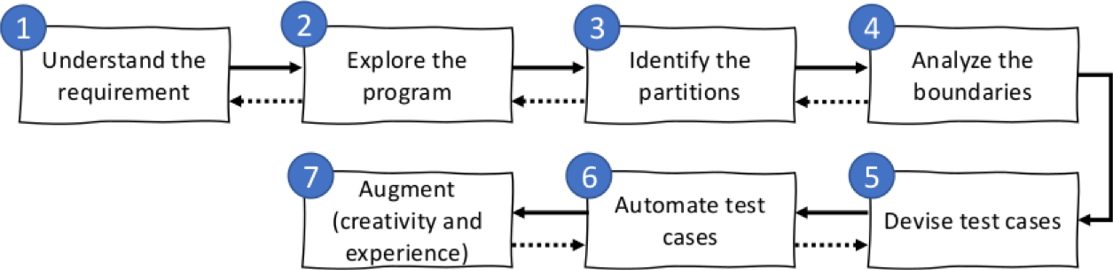
Reason about each input separately
Reason about how they interact with each other
Reason about domain-specific rules
Reason about the output
All of it with the requirements in mind, of course!!

Slide 5
Let's practice!
Method: intersection
This method returns a new list containing all elements that are contained in both given lists.
Inputs:
List1, a list of integers
List2, a list of integers
Outputs:
A new list.
In groups of 3, identify the partitions.
Time: 5 minutes
Afterwards, we will collect all partitions.

Slide 6
One possible way to reason about it
First, each input in isolation:
List1 and List2 are both lists. A few straightforward test cases:
Null
0 elements
1 element
Multiple elements
The requirements don't mention any specific constraints (e.g., max size of the list, range of the numbers in the list, etc), so we continue
How inputs interact:
The requirement is all about items in both sets, therefore:
List1 and List2 have elements in common
1 element
More than 1 element
List1 and List2 don't have elements in common

Slide 7
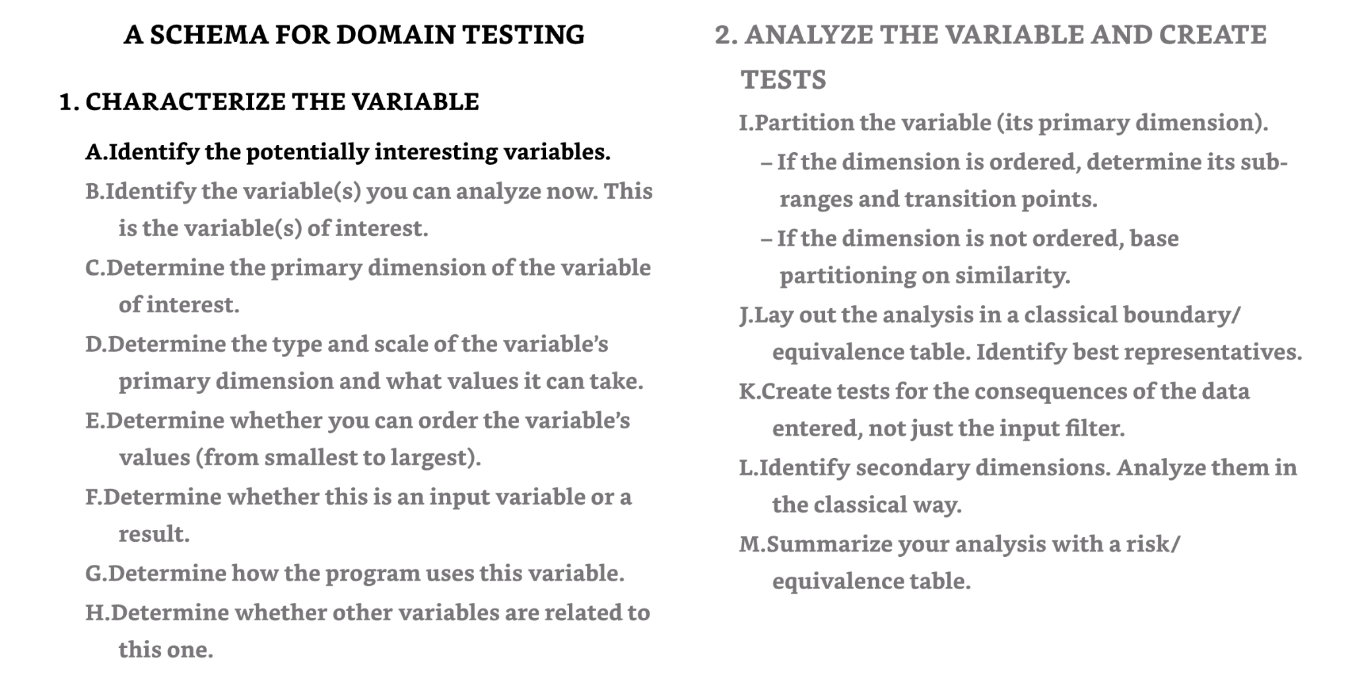
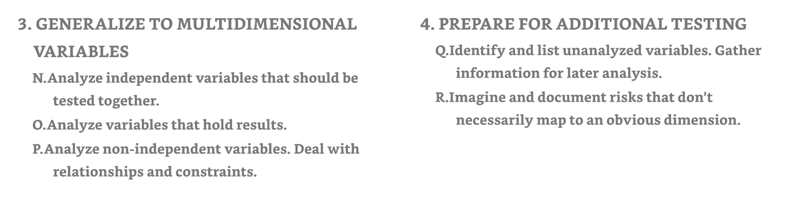
From Kaner et al. "Domain testing workbook"

Slide 8

Boundary testing
Bugs tend to happen on the boundaries!
Effective Software Testing, chapter 2

Slide 9


Boundary testing
n = random(); // [0,10]
if n > 5 eat
else eat
n = 4
n = 5
boundary
n = 6
This is what you should test!
Jeng, B., & Weyuker, E. J. (1994). A simplified domain-testing strategy. ACM Transactions on Software Engineering and Methodology (TOSEM), 3(3), 254-270.

Slide 10
Boundary testing: question 1
Condition: value > 100
What are the on and off points?
Time: 2 minutes

Slide 11
Boundary testing: question 1
Condition: value > 100
What are the on and off points?
On point = 100 (always the value in the condition)
The on-point makes the condition false ((100 > 100) == false), therefore the off-point should make the condition true.
Off point = 101

Slide 12
Boundary testing: question 2
Condition: value >= 101
What are the on and off points?
Time: 2 minutes

Slide 13
Boundary testing: question 2
Condition: value >= 101
What are the on and off points?
On point = 101 (always the value in the condition)
The on-point makes the condition true ((101 >= 101) == true), therefore the off-point should make the condition false.
Off point = 100

Slide 14
Boundary testing: question 3
Condition: value == 100
What are the on and off points?
Time: 2 minutes

Slide 15
Boundary testing: question 3
Condition: value == 100
What are the on and off points?
On point = 100 (always the value in the condition)
The on-point makes the condition true.
There are two off-points!
Off point = 101 and 99

Slide 16
Boundary testing: question 4
Condition: value > n + 1
What are the on and off points?
Time: 2 minutes

Slide 17
Boundary testing: question 4
Condition: value > n + 1
What are the on and off points?
On point = n + 1 (always the value in the condition)
The on-point makes the condition false (n + 1 > n + 1 == false).
The off-point should make the condition true
Off point = (n + 1) + 1
If n is an input parameter, then, you would pick any "n" and then "n+1".

Slide 18
Boundary testing: floating-point numbers
Condition: value <= 2.0
What are the on and off points?
Time: 2 minutes

Slide 19
Boundary testing: floating-point numbers
Condition: value <= 2.0
What are the on and off points?
Remember floating-point precision errors.
It depends on the context!

Slide 20
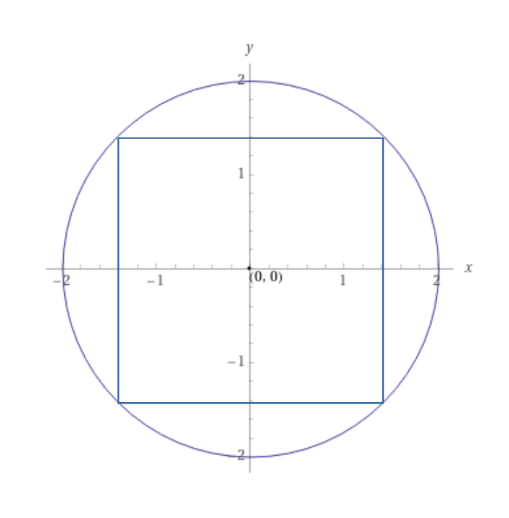
Boundary testing: floating-point numbers
Example context from a programming course: “In this assignment, you will create a few classes representing 2D objects. They will have contains methods that indicate whether one shape completely contains another shape. If we say "A contains B", we mean that the shape B is completely contained within A. In other words, it means that B is inside A. (This includes the edges. So if A is a rectangle with its lower left at (0.0, 0.0) and B is a point at (0.0, 0.0), we consider A to contain B.)”
Does the circle contain the rectangle?

Slide 21
Time for Q&A!

Slide 22
Input Space Coverage (ISP)
Equally applicable at several levels of testing
Unit
Integration
System
Easy to apply with no automation
Can adjust the procedure to get more or fewer tests
No implementation knowledge is needed
Just the input space

Slide 23
Input Domains
Input domain: all possible inputs to a program
Most input domains are so large that they are effectively infinite
Input parameters define the scope of the input domain
Parameter values to a method
Data from a file
Global variables
User inputs
We partition input domains into regions (called blocks)
Choose at least one value from each block
Input domain: Alphabetic letters
Partitioning characteristic: Case of letter
Block 1: upper case
Block 2: lower case

Slide 24
Partitioning Domain
Domain D
Partition D into a set of blocks
For any two blocks b1 and b2, b1∩b2=Φ
Together the blocks cover the domain D (complete)

Slide 25
What is a characteristic?
“A feature or quality belonging typically to a person, place, or thing and serving to identify it.”
Input: people
Characteristics: hair color, major
Blocks:
A=(red, black, brown, blonde, other)
B=(cs, swe, ce, math, ist, other)
Abstraction:
A = [ a1, a2, a3, a4, a5 ]
B = [ b1, b2, b3, b4, b5, b6 ]

Slide 26
Modeling the input domain (IDM)
Step 1 : Identify testable functions
Step 2 : Find all inputs, parameters, & characteristics
Step 3 : Model the input domain
Step 4 : Apply a test criterion to choose combinations of values
Step 5 : Refine combinations of blocks into test inputs

Slide 27
IDM Hints
More characteristics -> more tests
More blocks -> more tests
Do not use program source
Choose values strategically
Valid, invalid, special values
Explore boundaries
Balance the number of blocks in the characteristics

Slide 28
An Example
After partitioning characteristics into blocks, testers design tests by combining blocks from different characteristics
3 Characteristics (abstract): A, B, C
Abstract blocks: A = [a1, a2, a3,a4]; B = [b1, b2]; C = [c1, c2,c3]
A test starts by combining one block from each characteristic
Then values are chosen to satisfy the combinations
We use criteria to choose effective combinations

Slide 29
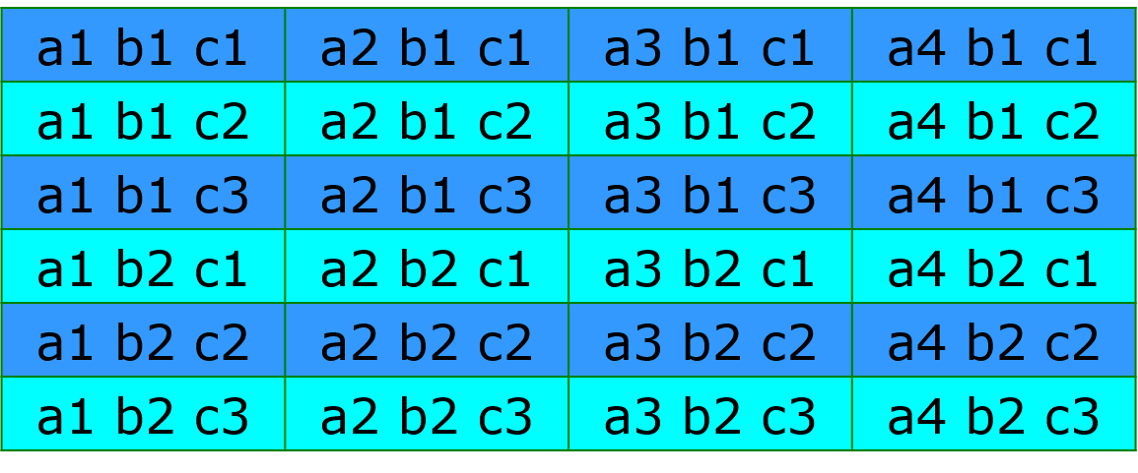
All combinations criterion (ACoC)
The most obvious criterion is to choose all combinations

Slide 30
Another Example
Input: students
Characteristics: Level, Mode, Major, Classification
Blocks:
Level: ( grad, undergrad )
Mode: ( full-time, part-time )
Major: ( cs, swe, other )
Classification: ( in-state, out-of-state )
Abstract IDM:
A = [ a1, a2 ] C = [ c1, c2, c3 ]
B = [ b1, b2 ] D = [ d1, d2 ]
How many tests are needed to satisfy ACoC?

Slide 31
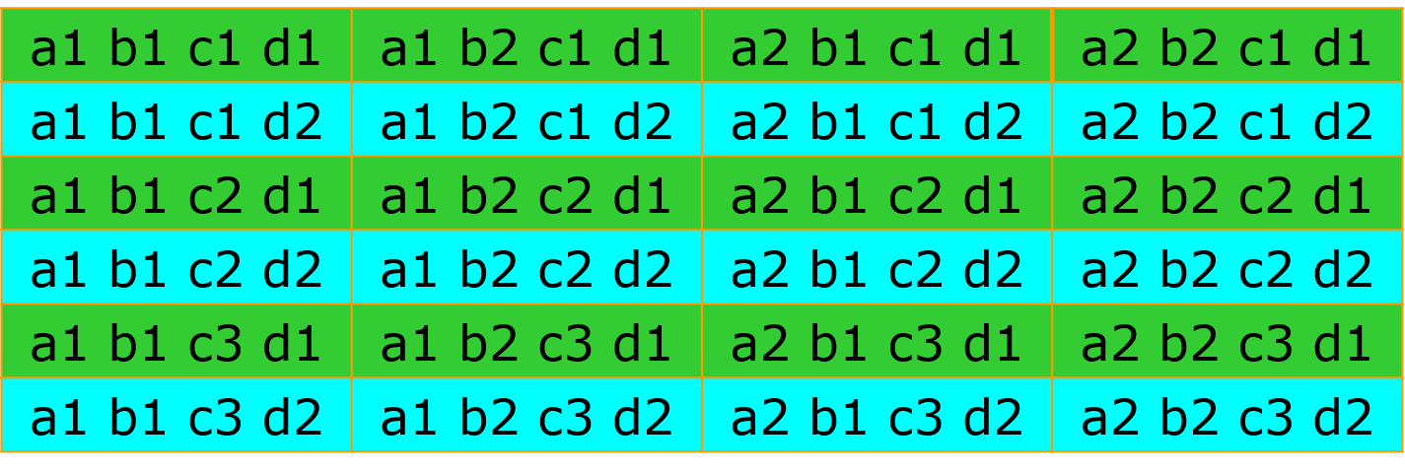
All combinations criterion (ACoC)

Slide 32
Each Choice Coverage (ECC)
Use at least one value from each block for each characteristic in at least one test case.
4 Characteristics: A, B, C, D
Abstract blocks: A = [a1, a2]; B = [b1, b2];
C = [c1, c2, c3]; D = [d1, d2]
How many tests are needed for ECC?
Design the (abstract) tests

Slide 33
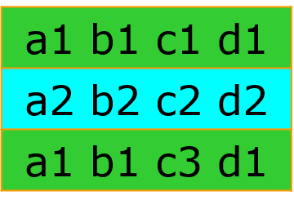
Each Choice Coverage (ECC)
Use at least one value from each block for each characteristic in at least one test case.
4 Characteristics: A, B, C, D
Abstract blocks: A = [a1, a2]; B = [b1, b2];
C = [c1, c2, c3]; D = [d1, d2]
How many tests are needed for ECC?
Design the (abstract) tests

Slide 34
Base Choice Coverage (BCC)
Choose a base choice block for each characteristic. Form a base test by using the base choice for each characteristic. Choose subsequent tests by holding all but one base choice constant and using each non-base choice in each other characteristic.

Slide 35
Base choice notes
The base test must be feasible
That is, all base choices must be compatible
Base choices can be
Most likely from an end-use point of view
Simplest
Smallest
First in some ordering
Happy path tests often make good base choices
The base choice is a crucial design decision
Test designers should document why the choices were made

Slide 36
An Example for BCC
4 Characteristics: A, B, C, D
Abstract blocks: A = [a1, a2]; B = [b1, b2];
C = [c1, c2, c3]; D = [d1, d2]
How many tests are needed for BCC?
Pick base values and write one base test
Design the remaining (abstract) tests

Slide 37
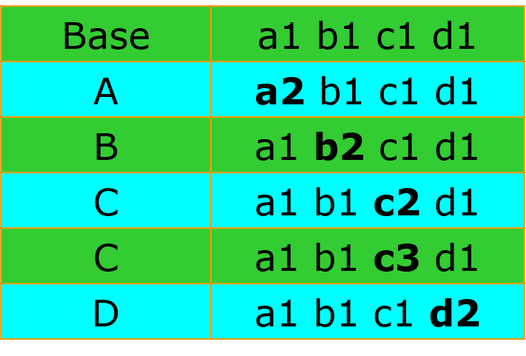
An Example for BCC
4 Characteristics: A, B, C, D
Abstract blocks: A = [a1, a2]; B = [b1, b2];
C = [c1, c2, c3]; D = [d1, d2]
How many tests are needed for BCC?
Pick base values and write one base test
Design the remaining (abstract) tests

Slide 38
Multiple Base Choice Coverage (MBCC)
Choose at least one, and possibly more, base choice blocks for each characteristic. Form base tests by using each base choice for each characteristic at least once. Subsequent tests are chosen by holding all but one base choice constant for each base test and using each non-base choice in each other characteristic.
For our example: Two base tests: a1, b1, c1, d1 a2, b2, c2, d2
Tests from a1, b1, c1, d1: a1, b1, c3, d1
Tests from a2, b2, c2, d2: a2, b2, c3, d2

Slide 39
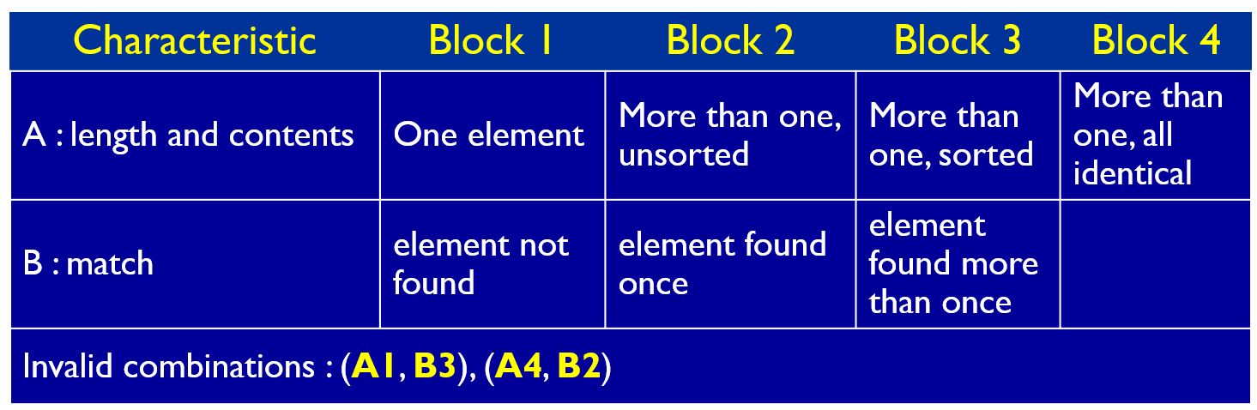
Constraints Among Characteristics
Some combinations of blocks are infeasible
These are represented as constraints among blocks
public boolean findElement (List list, Object element)
// Effects: if list or element is null throw NullPointerException
// else return true if element is in the list, false otherwise

Slide 40
Input Space Partitioning Summary
Fairly easy to apply, even with no automation
Convenient ways to add more or less testing
Applicable to all levels of testing – unit, class, integration, system, etc.
Based only on the input space of the program, not the implementation
Simple, straightforward, effective, and widely used

Slide 41

License
The slides are licensed under CC-BY-NC-SA 2.0
https://creativecommons.org/licenses/by-nc-sa/4.0/
If you use this deck of slides in any way (as is or derived), please add a reference to the book and to its website (effective-software-testing.com)
The photos come from various artists in Unsplash.
The icons come from iconfinder.com.
Some slides are also adapted from

Slide 42
Lab-1 Submission
Email the TA and CC me. Use the subject line: “LSU-CSC-4332-Lab-1 <Your Name> <LSU ID>”.
Attach a screenshot of your IDE showing that the code ran successfully, and your testfile.

